Slide 1


Smart Building Integration and Energy Optimization with Electrochromic Windows
MAE 576: Energy Efficiency
A Presentation by:
Mallikarjun Vadi [1220044956]
Surya Sudarsan Naveen Ravula [1225834027]
Anupama Satya Kanchustambam [1225758846]
Lalith Sai Madhav Rayala [1226017903]
Ajay Kumar Sharma [1225812421]

Slide 2
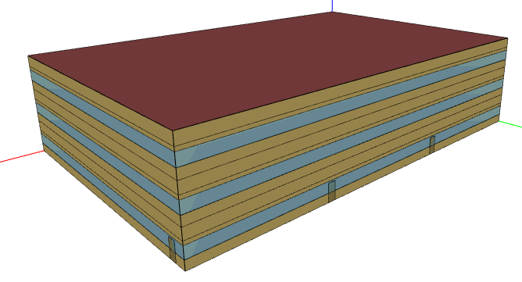
Modeling the building
Source: (“Prototype Building Models | Building Energy Codes Program”)
File Name: IECC_OfficeMedium_STD2021_Phoenix
Total Building Area: 4982.19 sq. m.
Weather File | Phoenix Sky Harbor (PHX)AZ USA TMY3 WMO#=722745
Latitude [deg] | 33.4352 N
Longitude [deg] | 112.0101 W
Elevation [m] | 809.00
Time Zone | -7.0
North Axis Angle [deg] | 0.00
Rotation for Appendix G [deg] | 0.00
Hours Simulated [hrs.] | 8760.00
Fig. 1: IECC Prototype building model – “Medium Office Building”
(IECC: The International Energy Conservation Code)
 | Total
Gross Roof Area | 1660.71 [m2]
Sky light Area | 0 [m2]
Sky light – Roof ratio | 0
 | Total
Gross Wall Area | 1977.67 [m2]
Window Area | 593.29 [m2]
Gross Window to Wall ratio [%] | 30 %
Building Envelope details:
Table. 1 (a): Window-Wall Ratio
Table. 1 (b): Sky light - Roof Ratio

Slide 3
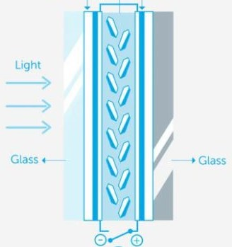
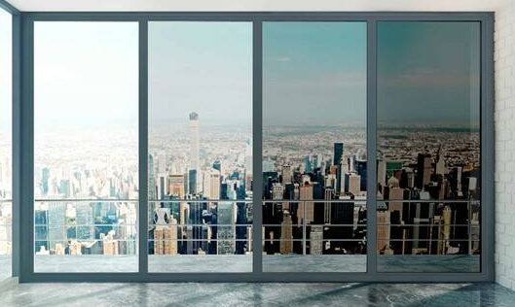
ElectroChromic Windows Construction and Modeling
Tint settings
Construction & Details
Reference: Tint Settings, Pg.3, Dutta (2018)
Transparent conductor: 1 mm (each side)
1
Active Electrochromic layer: 1 mm(each side)
2
Lithium ions
3
Passive counter Electrode
4
Fig.2: Cross-Sectional view of an EC Glass
Tint state 1
VT = 62.1%
SHGC = 0.443
U-factor = 0.289
[BTU/hr-ft2-F]
Tint state 2
VT = 41.3%
SHGC = 0.28
U-factor = 0.289
[BTU/hr-ft2-F]
Tint state 3
VT = 5.6%
SHGC = 0.104
U-factor = 0.289
[BTU/hr-ft2-F]
Tint state 4
VT = 1.1%
SHGC = 0.087
U-factor = 0.289
[BTU/hr-ft2-F]

Slide 4
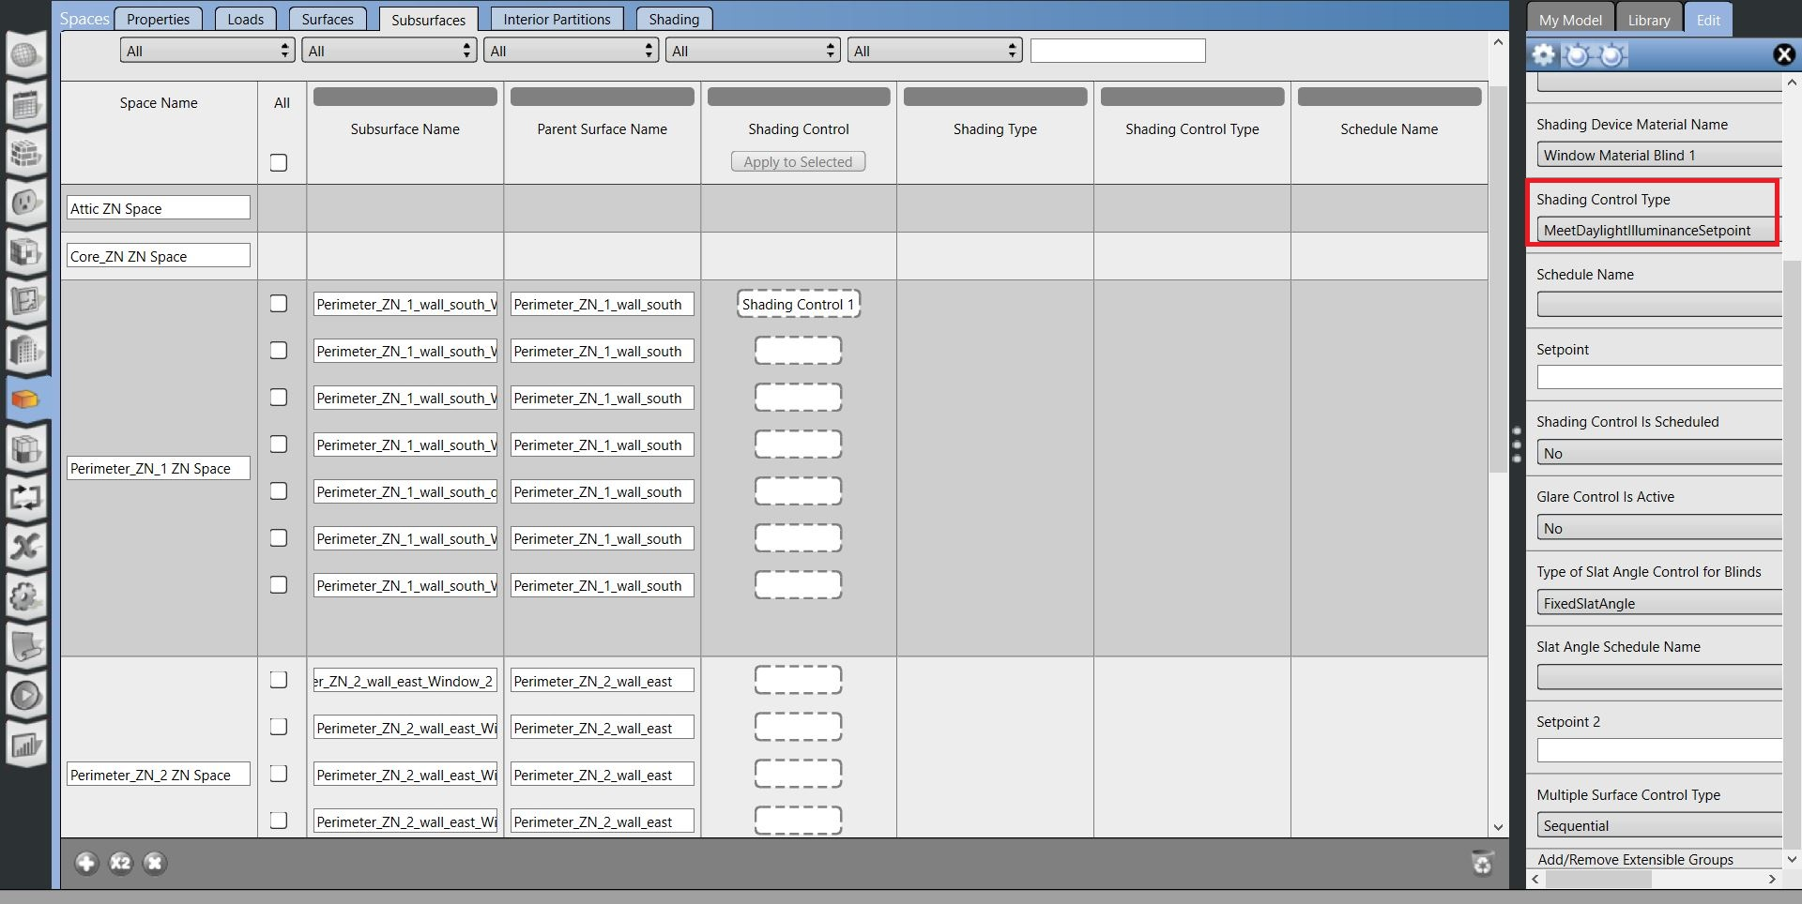
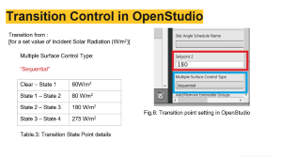
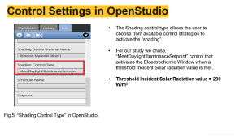
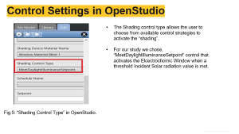

Dynamic modeling of Electrochromic Windows
Using OpenStudio & EnergyPlus (E+)
Fig.4: “Shading Control type” settings in OpenStudio.

Slide 5
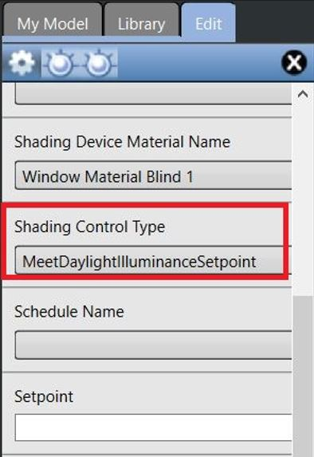
Control Settings in OpenStudio
The Shading control type allows the user to choose from available control strategies to activate the “shading”.
For our study we chose, “MeetDaylightIlluminanceSetpoint” control that activates the Elcectrochomic Window when a threshold Incident Solar radiation value is met.
Fig.5: “Shading Control Type” in OpenStudio.

Slide 6
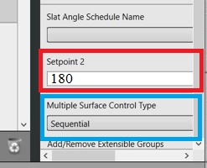
Transition Control in OpenStudio
Transition from :
[for a set value of Incident Solar Radiation (W/m²)]
Multiple Surface Control Type:
“Sequential”
Clear – State 1 | 60W/m²
State 1 – State 2 | 80 W/m²
State 2 – State 3 | 180 W/m²
State 3 – State 4 | 275 W/m²
Fig.6: Transition point setting in OpenStudio
Table.3: Transition State Point details

Slide 7
Energy Usage of the building
Annual Natural Gas usage (A) | 97.41 GJ | 120.50 GJ
Electrical Energy Usage (B) | 1544.41 GJ | 1344.36 GJ
Total Annual Energy Usage (A + B) | 1641.82 GJ | 1464.86 GJ

Slide 8

Savings (ES, CS and Carbon savings)
Annual Energy Savings (ES)
Total Savings in Electric energy annually (ES) = 49155.5556 kWh/ yr.
Electricity unit price in Arizona (commercial)
Cost per kWh in Arizona = $0.116/kWh (Source: Table 5.6.A. Average Price of Electricity to Ultimate Customers by End-Use Sector)
Net Annual Cost Savings (CS)
CS = ES * Cost per kWh = (49155.5556 * $0.116/kWh) = $ 5,702.04/yr.
Increase in the Natural gas costs = $226.67/yr
Net CS = ($ 5,702 - $226.08) = $5,475 / yr
Reduction in Carbon dioxide Emissions:
Carbon Emission Savings = Usage Savings (ES)× 𝐸𝐹 where EF is the emission factor, or the amount of CO2 generated per kWh by Arizona powerplants (0.694 pounds per kWh)
Therefore, Carbon Emission Savings = (49155.5556 * 0.694) = 34,113.95 lb /yr.

Slide 9
References:
“Prototype Building Models | Building Energy Codes Program.”, Office of & Renewable energy, http://www.energycodes.gov/prototype-building-models.
Dutta, Ranojoy. “Modeling an Electrochromic Window Using a Multi-Criteria Control Strategy.” Publications.ibpsa.org, ASHRAE/IBPSA-USA, 2018, publications.ibpsa.org/conference/paper/?id=simbuild2018_C022. Accessed 22 Nov. 2023.
“Electric Power Monthly - U.S. Energy Information Administration.” Eia.gov, 2016, www.eia.gov/electricity/monthly/.
“EIA - State Electricity Profiles.” www.eia.gov, www.eia.gov/electricity/state/arizona/.

